Slide 1
EXAM SCHEDULER
DISCRETE MATHEMATICS PROJECT

Slide 2
GROUP MEMBERS
ARPIT SINGH URN:2019-B-28092001C
JAINEEL PETIWALE URN:2019-B-21032001
JAINIL GAJJAR URN:2019-B-28092001A
JANHAVI GHOGLE URN:2019-B-28092001

Slide 3
OBJECTIVE
To schedule the examination subjects in such a way that students taking any combination of subjects have no conflict

Slide 4
OTHER TOPICS CONSIDERED
Fake News Detection Program For an input statement, it will display the probability of the news to be true
DM Calculator It will be used to calculate set theory, permutations and combinations and probability

Slide 5
MOTIVE TO CHOOSE THIS TOPIC
Can be used in day to day life
To ease the process of exam scheduling for the institute.

Slide 6
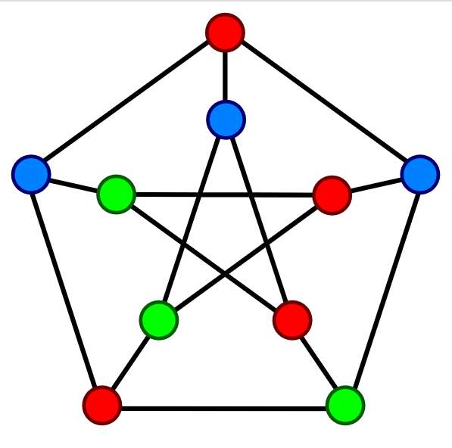
GRAPH COLORING
it is a way of coloring the vertices of a graph such that no two adjacent vertices are of the same color.
The objective is to minimize the number of colors while coloring a graph.
The smallest number of colors required to color a graph G is called its chromatic number of that graph

Slide 7
OTHER APPLICATIONS OF GRAPH COLORING
Mobile Radio Frequency
Sudoku
Map Colouring

Slide 8

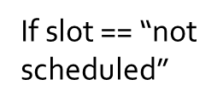
WORKING OF PROGRAM
This BLOCK will execute n times
Input the no of subjects = n
Input the name of the subject and slot
True
Print “Thank you, your exams are scheduled
Input the Branch
False
True
Print “Slot not available
If input = 1
End
If input = 1
False
Display the timetable

Slide 9
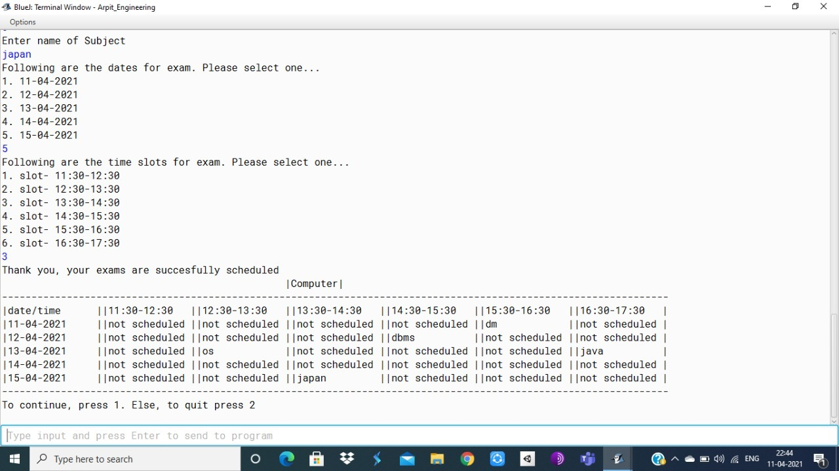
RESULT

Slide 10
CONCLUSION
It saves time
Effortless way of exam scheduling

Slide 11
HOW CAN WE IMPROVE?
This program has limit of 30 subjects
We can use GUI to create more readable timetable
We can also schedule teachers to invigilate for the exam

Slide 12
THANK YOU

